Slide 1

The Geography of Complex Knowledge Pierre-Alexandre Balland

Slide 2
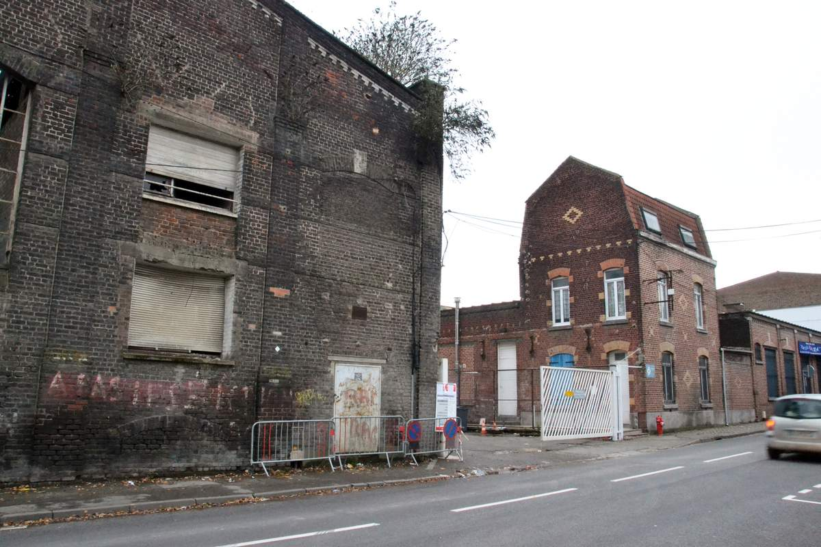

The great spatial divide

Slide 3
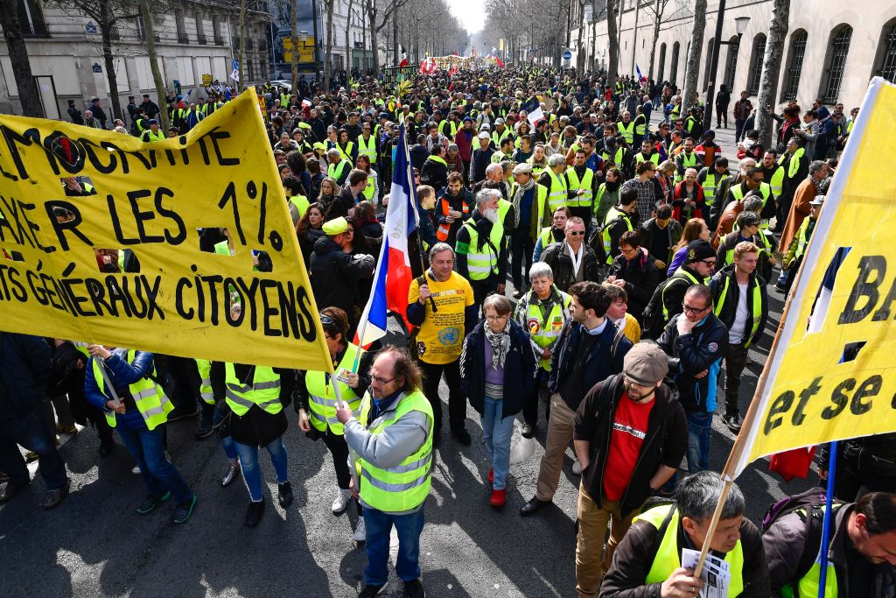

Slide 4
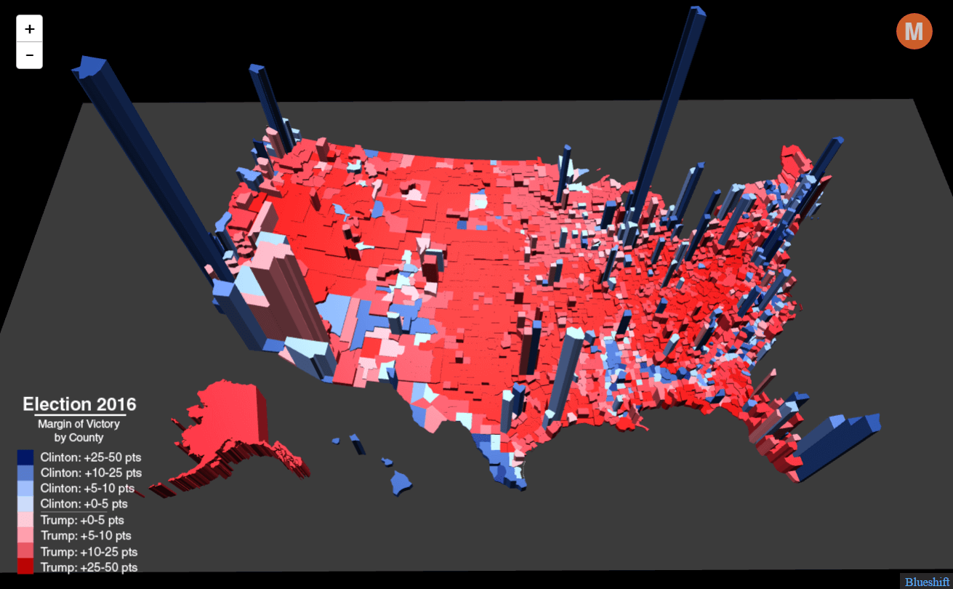

Slide 5
Winner Takes-All Economy
Notes:
products can be widely distributed (broad audience and network effects)
Rosen said that such breakthroughs as motion pictures, radio, and TV had greatly broadened the audiences—and hence the rewards—for those in show business and sports. Thirty years later, Brynjolfsson sees a similar effect for high-tech entrepreneurs, whose ideas and products can be widely distributed and produced thanks to software and other digital technologies. Why hire a local tax consultant when you can use a cheap, state-of-the-art program that is constantly being updated and refined? Likewise, why buy a second-best program or app? The ability to copy software and distribute digital products anywhere means customers will buy the top one. Why use a search engine that is almost as good as Google? Such economic logic now rules a growing share of the marketplace; it is, according to Brynjolfsson, an increasingly important reason why a few entrepreneurs, including the founders of such startups as Instagram, are growing rich at a staggering rate.

Slide 6


The World of Knowledge Consumption is Getting
Flatter
Digital technologies, transports and globalization allows products to be widely distributed
Winner Takes-All Economy
Notes:
products can be widely distributed (broad audience and network effects)
Rosen said that such breakthroughs as motion pictures, radio, and TV had greatly broadened the audiences—and hence the rewards—for those in show business and sports. Thirty years later, Brynjolfsson sees a similar effect for high-tech entrepreneurs, whose ideas and products can be widely distributed and produced thanks to software and other digital technologies. Why hire a local tax consultant when you can use a cheap, state-of-the-art program that is constantly being updated and refined? Likewise, why buy a second-best program or app? The ability to copy software and distribute digital products anywhere means customers will buy the top one. Why use a search engine that is almost as good as Google? Such economic logic now rules a growing share of the marketplace; it is, according to Brynjolfsson, an increasingly important reason why a few entrepreneurs, including the founders of such startups as Instagram, are growing rich at a staggering rate.

Slide 7
The World of Knowledge Production is Getting
Spikier
Knowledge increasingly concentrates as it becomes more complex
Winner Takes-All Economy
Notes:
products can be widely distributed (broad audience and network effects)
Rosen said that such breakthroughs as motion pictures, radio, and TV had greatly broadened the audiences—and hence the rewards—for those in show business and sports. Thirty years later, Brynjolfsson sees a similar effect for high-tech entrepreneurs, whose ideas and products can be widely distributed and produced thanks to software and other digital technologies. Why hire a local tax consultant when you can use a cheap, state-of-the-art program that is constantly being updated and refined? Likewise, why buy a second-best program or app? The ability to copy software and distribute digital products anywhere means customers will buy the top one. Why use a search engine that is almost as good as Google? Such economic logic now rules a growing share of the marketplace; it is, according to Brynjolfsson, an increasingly important reason why a few entrepreneurs, including the founders of such startups as Instagram, are growing rich at a staggering rate.

Slide 8
The World of Knowledge Consumption is Getting
Flatter
The World of Knowledge Production is Getting
Spikier
Digital technologies, transports and globalization allows products to be widely distributed
Knowledge increasingly concentrates as it becomes more complex
Winner Takes-All Economy
Notes:
products can be widely distributed (broad audience and network effects)
Rosen said that such breakthroughs as motion pictures, radio, and TV had greatly broadened the audiences—and hence the rewards—for those in show business and sports. Thirty years later, Brynjolfsson sees a similar effect for high-tech entrepreneurs, whose ideas and products can be widely distributed and produced thanks to software and other digital technologies. Why hire a local tax consultant when you can use a cheap, state-of-the-art program that is constantly being updated and refined? Likewise, why buy a second-best program or app? The ability to copy software and distribute digital products anywhere means customers will buy the top one. Why use a search engine that is almost as good as Google? Such economic logic now rules a growing share of the marketplace; it is, according to Brynjolfsson, an increasingly important reason why a few entrepreneurs, including the founders of such startups as Instagram, are growing rich at a staggering rate.

Slide 9
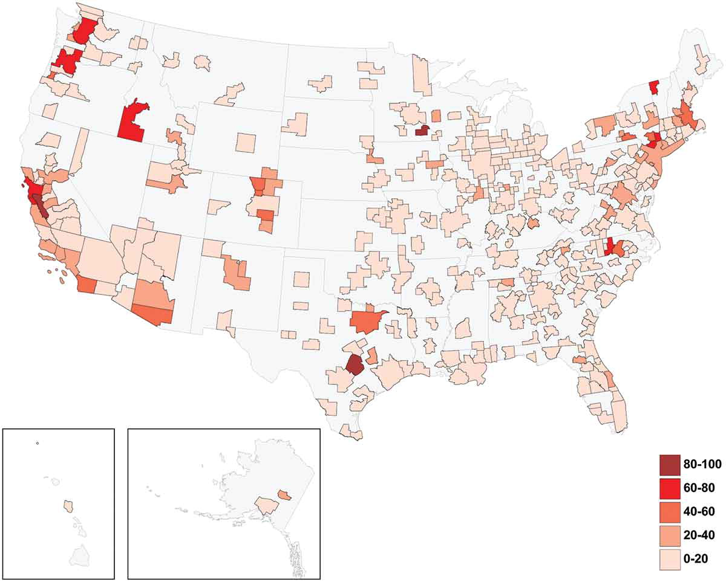
Knowledge complexity scores
Balland and Rigby, 2017, Economic Geography

Slide 10
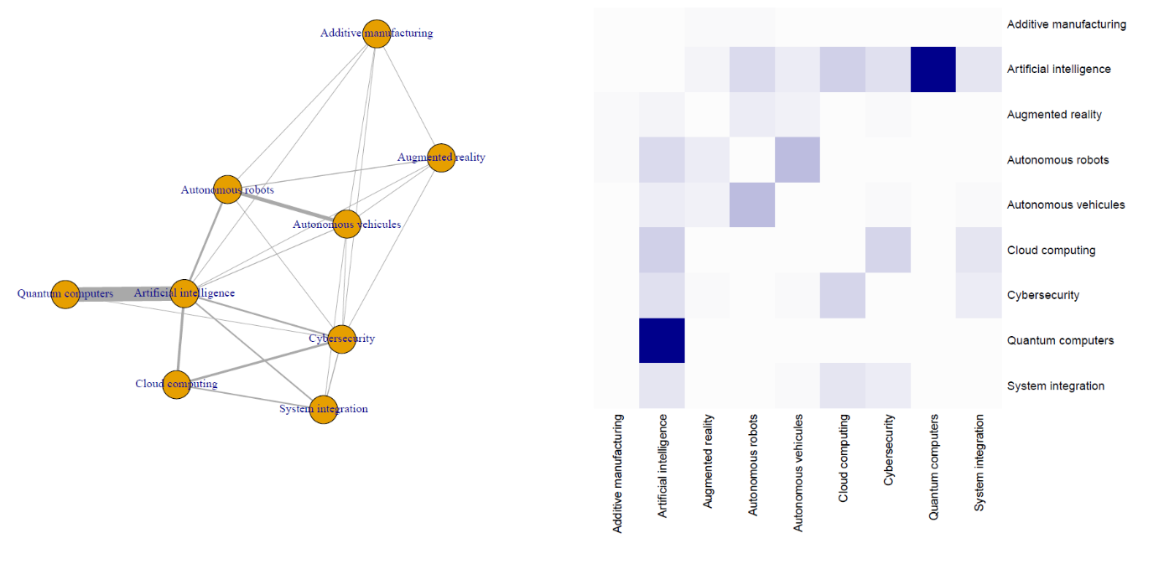
European Hubs of the industries of the future

Slide 11
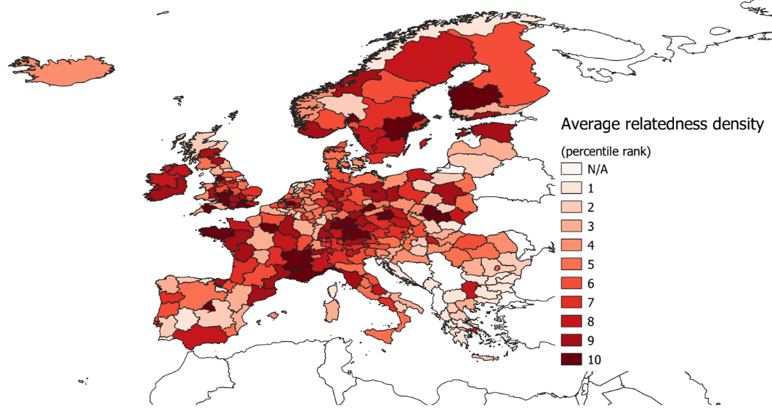
European Hubs of the industries of the future
Balland and Boschma, 2019, World Bank Report

Slide 12

Unequal distribution of econ. activities
Balland, Jara-Figueroa, Petralia, Steijn& Rigby and Hidalgo, PGR

Slide 13
Superlinear scaling – patents in US cities

Slide 14
Superlinear scaling – patents in GMS cities

Slide 15
From Complexity to Spatial Inequality
Knowledge complexity
Specialization of individuals
Need for interactions (networks)
Distance-based costs
Unequal geography of innovation
Notes:
Division of labor and tech progress allows for division of labour
http://www.nature.com/articles/sdata201674

Slide 16
From Complexity to Spatial Inequality
Knowledge complexity
Specialization of individuals
Need for interactions (networks)
Distance-based costs
Unequal geography of innovation
Notes:
Division of labor and tech progress allows for division of labour

Slide 17
From Complexity to Spatial Inequality
Knowledge complexity
Specialization of individuals
Need for interactions (networks)
Distance-based costs
Unequal geography of innovation
Notes:
Division of labor and tech progress allows for division of labour

Slide 18
From Complexity to Spatial Inequality
Knowledge complexity
Specialization of individuals
Need for interactions (networks)
Distance-based costs
Unequal geography of innovation
Notes:
Division of labor and tech progress allows for division of labour

Slide 19
The geography of complex knowledge
Knowledge complexity
Specialization of individuals
Need for interactions (networks)
Distance-based costs
Knowledge Hubs = Cities
Notes:
Division of labor and tech progress allows for division of labour

Slide 24
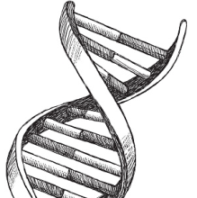
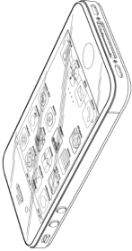
The Historical Gap
There is virtually no historical and systematic analysis on the geography of innovation and technological change prior to 1975.
Biotechnology
1790 1820 1850 1880 1910 1940 1975 2010
1st U.S. Patent
Information & Communication
Notes:
Eli Whitney - Mechanical cotton gin - 1794 (NA in Google Patents)
Samuel Morse - Electrical Telegraph – 1840 - https://www.google.com/patents/US1647
Alexander Graham Bell – Telephone – 1876 - https://www.google.com/patents/US174465
Nikolaus August Otto – Internal combustion engine 1876 - https://www.google.com/patents/US194047

Slide 25
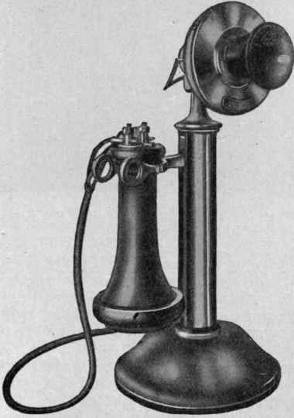
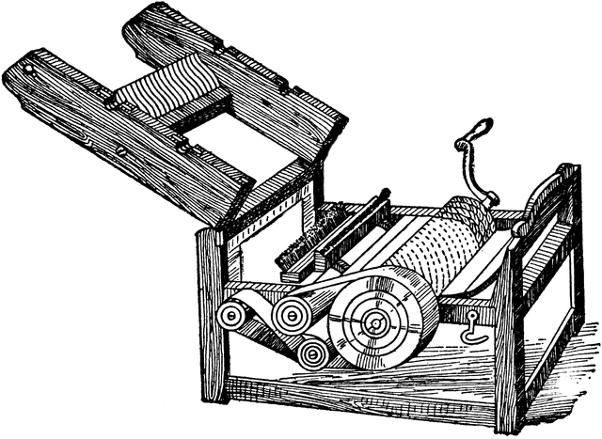
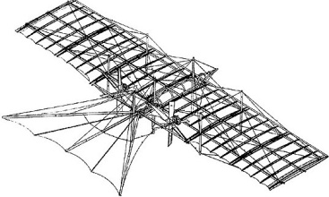
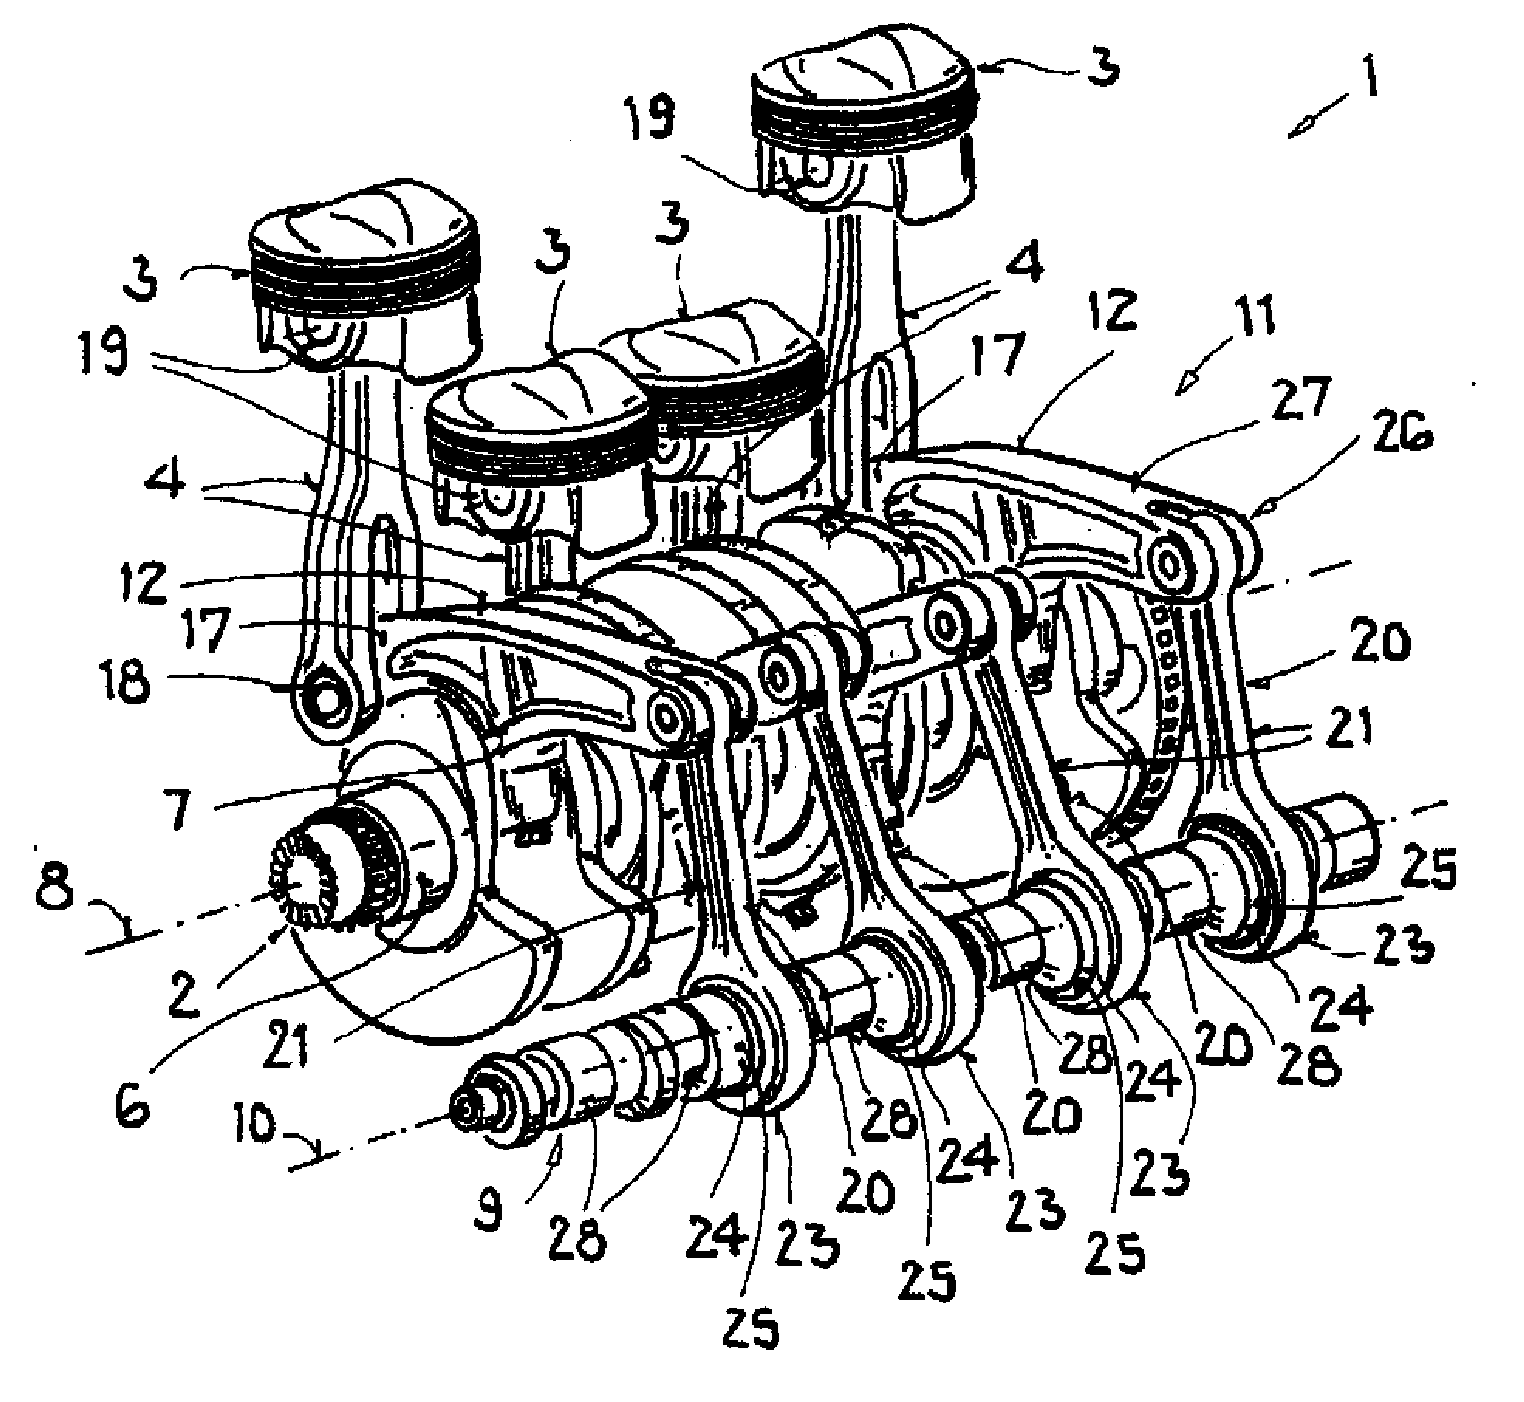
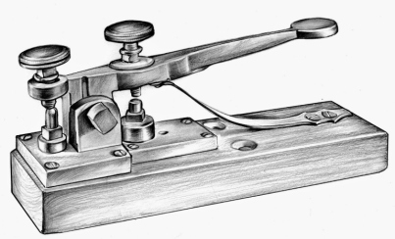

The Historical Gap
There is virtually no historical and systematic analysis on the geography of innovation and technological change prior to 1975.
Cotton Gin
Telephone
Airplane
Biotechnology
1790 1820 1850 1880 1910 1940 1975 2010
1st U.S. Patent
Telegraph
Internal combustion engine
Semiconductor
Information & Communication
Notes:
Eli Whitney - Mechanical cotton gin - 1794 (NA in Google Patents)
Samuel Morse - Electrical Telegraph – 1840 - https://www.google.com/patents/US1647
Alexander Graham Bell – Telephone – 1876 - https://www.google.com/patents/US174465
Nikolaus August Otto – Internal combustion engine 1876 - https://www.google.com/patents/US194047

Slide 26
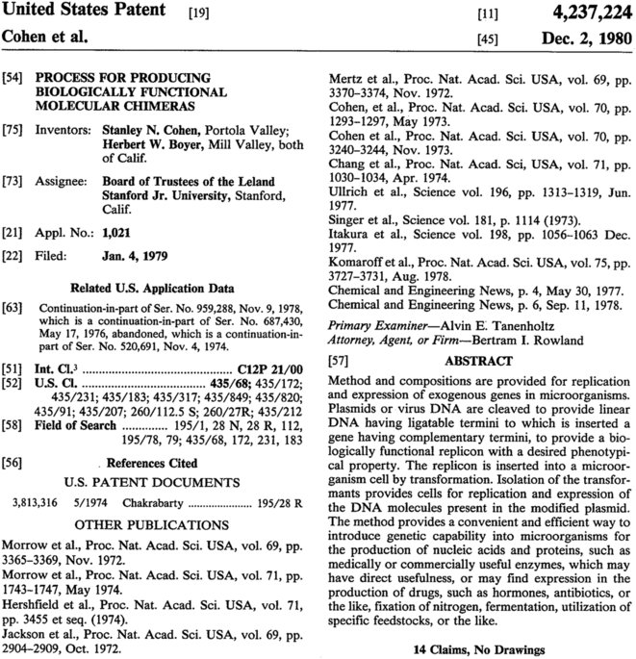
Historical Patent Dataset (HistPat)
www.nature.com/articles/sdata201674 (Petralia, Balland, Rigby; 2016)
~ 7,000,000 US patents
1790 to 2016
Geography of patents (county level – 4,000)
And their tech classes (436 classes; 150,000 sub-classes)
…

Slide 27
Complexity and scaling (1850-2000)

Slide 28
Complexity and scaling (1850-2000)

Slide 29
Complexity and scaling (1850-2000)

Slide 30
Take-Away Messages
Knowledge complexity drives spatial inequality

Slide 31
Take-Away Messages
Knowledge complexity drives spatial inequality
The urban advantage (scaling) has continuously increased over the past 200+ years – the world is getting spikier

Slide 32
Take-Away Messages
Knowledge complexity drives spatial inequality
The urban advantage (scaling) has continuously increased over the past 200+ years – the world is getting spikier
Scaling reflects knowledge complexity (most complex technologies & industries scale the most)

Slide 33
Take-Away Messages
Knowledge complexity drives spatial inequality
The urban advantage (scaling) has continuously increased over the past 200+ years – the world is getting spikier
Scaling reflects knowledge complexity (most complex technologies & industries scale the most)
Is it just the beginning of the great spatial divide we start to observe?

Slide 34
Take-Away Messages
Knowledge complexity drives spatial inequality
The urban advantage (scaling) has continuously increased over the past 200+ years – the world is getting spikier
Scaling reflects knowledge complexity (most complex technologies & industries scale the most)
Is it just the beginning of the great spatial divide we start to observe?
How to make sure that policy like the smart specialization strategy won’t increase this great spatial divide?

Slide 35
Thanks!

Slide 36
Smart Specialization Strategy
Complexity
High Risks
High Benefits
Low Risks
High Benefits
High Risks
Low Benefits
Low Risks
Low Benefits
Relatedness
Balland et al. (2018)

Slide 37


Slide 38
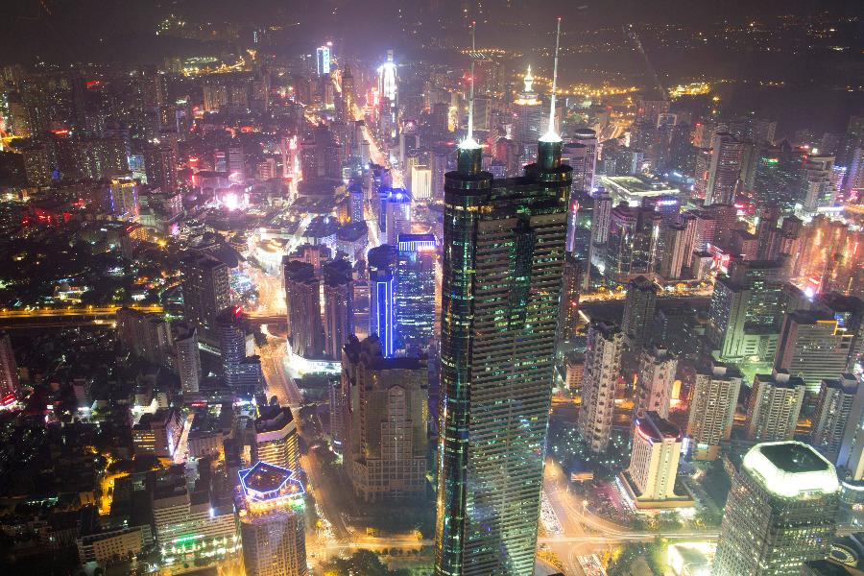
Unprecedented growth of cities
Notes:
Let me start by confessing to you that I have a strong disaffection for theory on the death of distance, weakening effect of geography…for 2 reasons

Slide 39

Unprecedented growth of int. bus. travel
Notes:
Easier to move people rather than information
1.2 trillion a year
Grows at 6.5% a year
1.5% world GDP – GDP of Spain

Slide 40
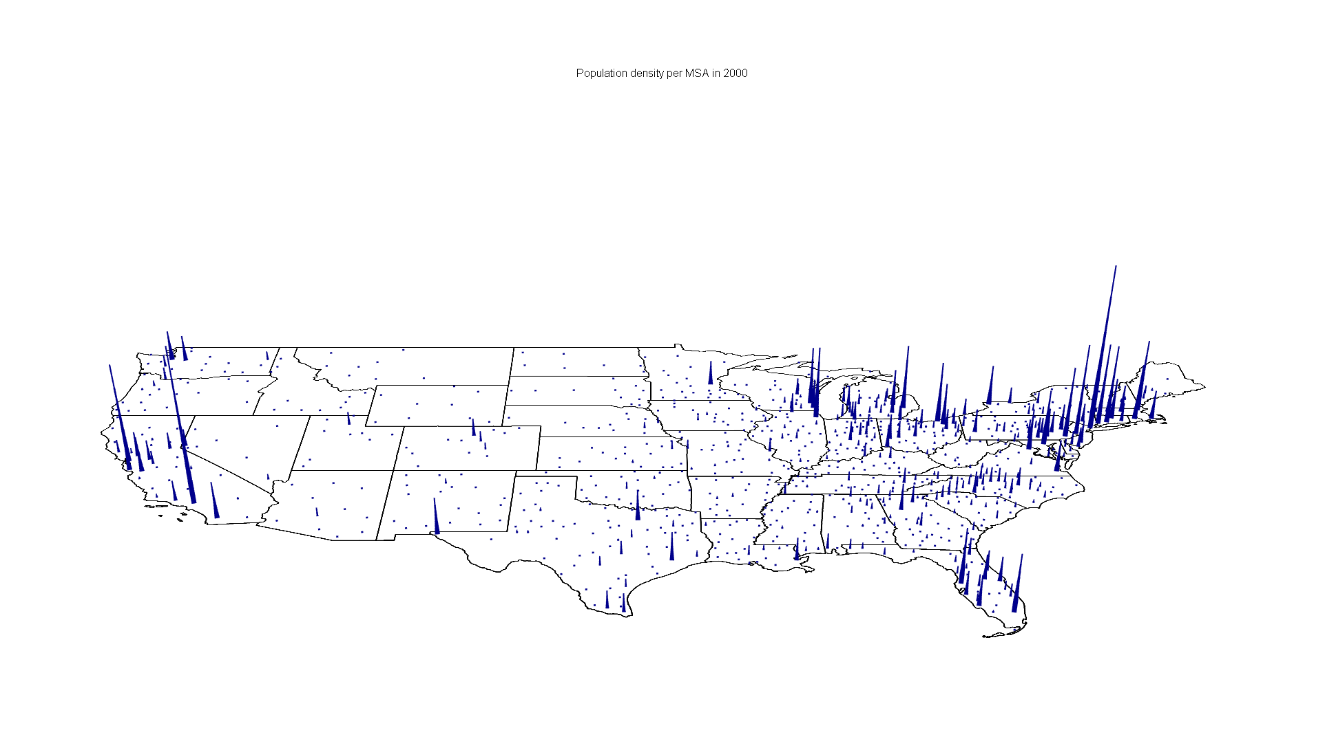
Where America Lives
Population Density per Metropolitan Statistical Area (MSA) in 2010
Data Source: United States Census Bureau

Slide 41
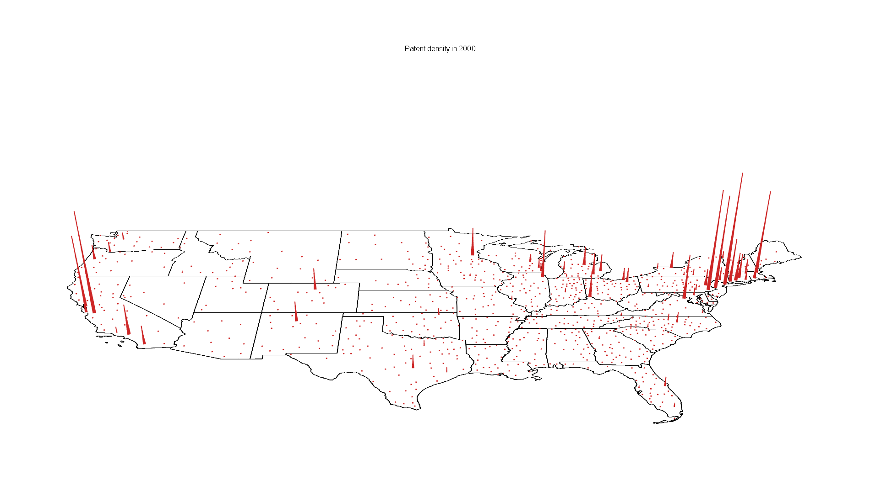
Where America Innovates
Patent Density per Metropolitan Statistical Area (MSA) in 2010
Data Source: United States Patent Office

Slide 42
Where America Innovates
Worldwide, Tokyo, San Jose, New York, Boston, Kanagawa, Shenzhen, Osaka, San Diego, Los Angeles, and Seoul account for 2 % of the population but 24 % of the world’s patent applications
Patent Density per Metropolitan Statistical Area (MSA) in 2010
Data Source: United States Patent Office

Slide 43
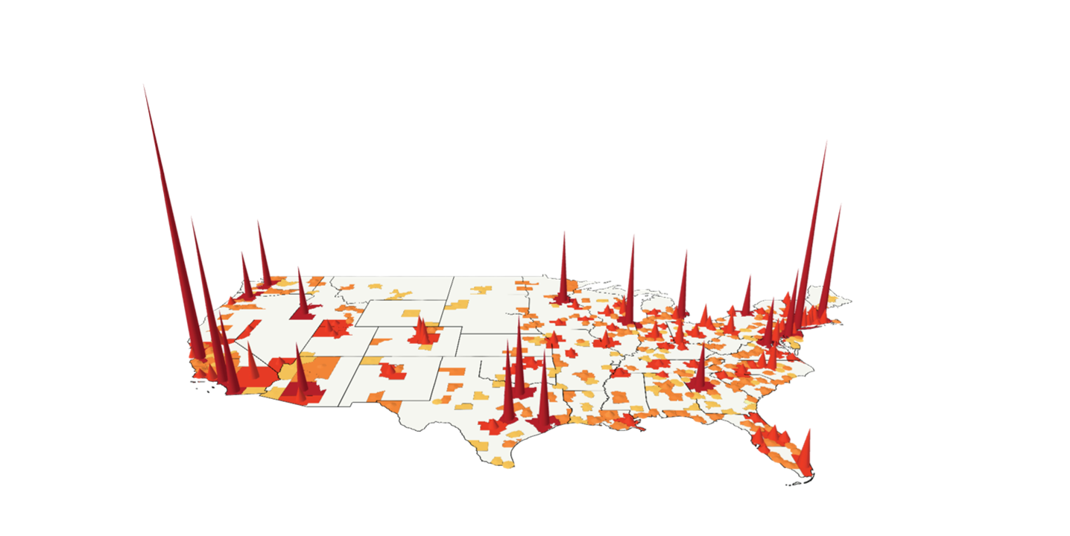
Knowledge Complexity & Spatial Inequality

